Slide 1
BOOTCAMP DATA ANALYSIS
Notes:
Pau

Slide 2
P O L L U T I O N .
Notes:
Pau

Slide 3
91%
of the world’s population lives in places where air quality
exceeds WHO guideline limits
(World Health Organization, 2019)
Notes:
Pau

Slide 4
World’s largest environmental health risk .
Notes:
https://www.who.int/sustainable-development/BreatheLife-Technical-Flyer.pdf?ua=1
https://www.who.int/airpollution/fact-sheets/en/
Pau

Slide 5
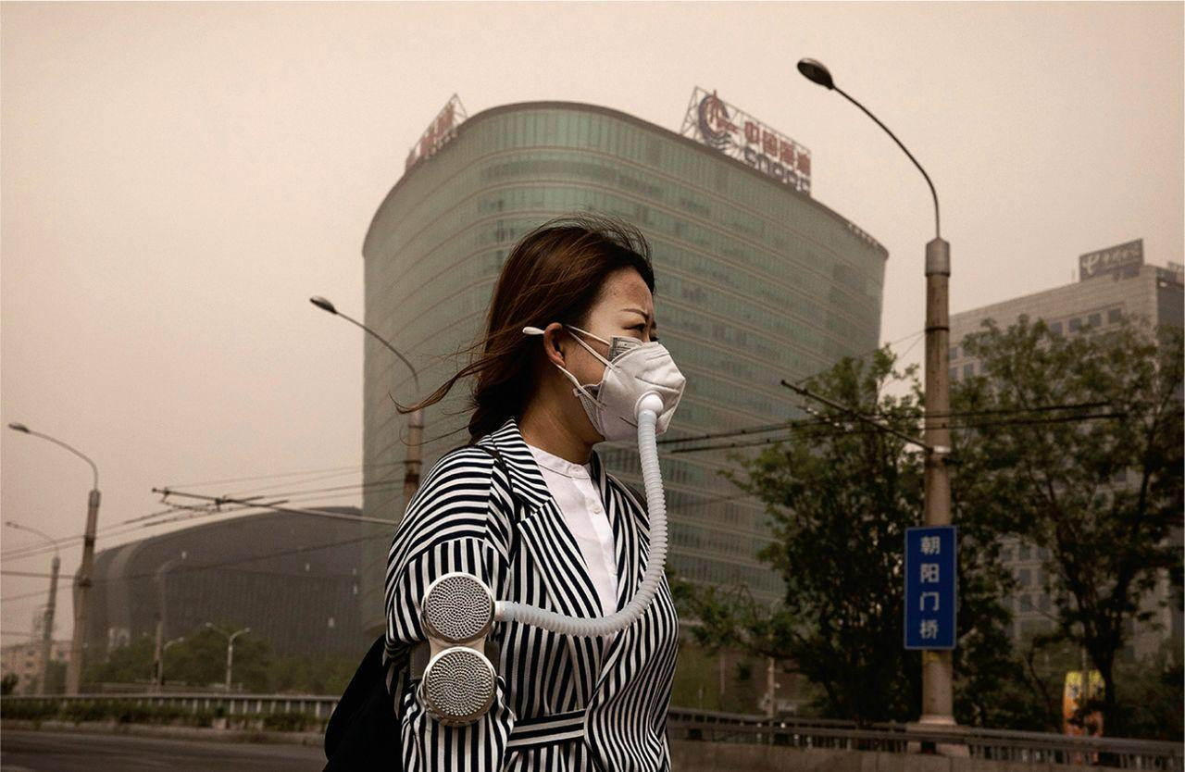
We choose
CLEAN
PROGRESS.
Notes:
Pau

Slide 6
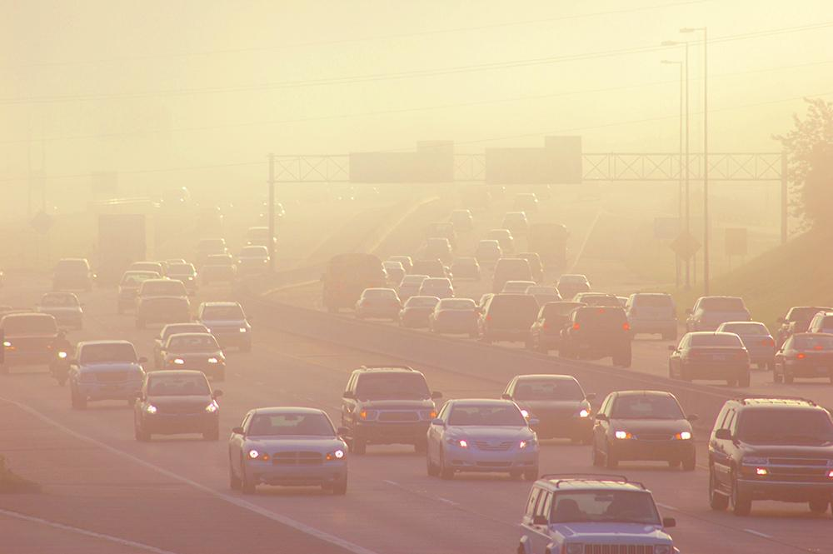
H Y P O T H E S I S
Notes:
Morado

Slide 7
“
”
Does economic growth reduce CO2 emissions?
Notes:
Morado

Slide 8
C U R I O S I T Y
Notes:
Morado

Slide 9
Q U E S T I O N S
1
Which countries are the most similar in population in 3 different economic
segments (developed, developing and underdeveloped)?
Do renewable energies cause a decrease in the use of fossil
fuels?
Which type of countries have grown the most their GDP per capita
in the last three decades?
Is there a correlation between the development of a country and
their carbon emissions?
Do developing countries rely more than developed countries on
the use of fossil fuels?
How much renewable energies does each country use?
2
3
4
5
6
Notes:
Morado

Slide 10







D A T A & D A T A E X P L O R A T I O N
We downloaded three datas sets from the World Bank webpage:
List of Countries by Population
List of Countries by GDP Per Cápita
List of Countries by Pollution in CO2 emissions
We started by comparing countries with similar populations at year 2017 and delimited a list of countries with populations between 60M and 130M.
From the list of countries by GDP Per Capita we took year 2017 and grouped all the countries in three categories:
Developed Countries
Developing Countries
Underdeveloped Countries
We found the intersection between our list of countries with the delimited population and the GDP Per Capita list.
We obtained 3 countries from each group.
Notes:
FRANCISCO

Slide 11




O U R D A T A
JP
GB
FR
MX
TR
TH
PH
EG
VN
Countries
Pollution
GDP
GDP
per capita
Resources
Notes:
Francisco

Slide 12
Developed
Countries
GDP
per capita
Pollution
Resources
LMIC
Developing
Countries
GDP
per capita
Pollution
Resources
ANALYSIS PROCESS
LEDC
Less Developed
Countries
GDP
per capita
Pollution
Resources
‹#›
Notes:
Francisco

Slide 13
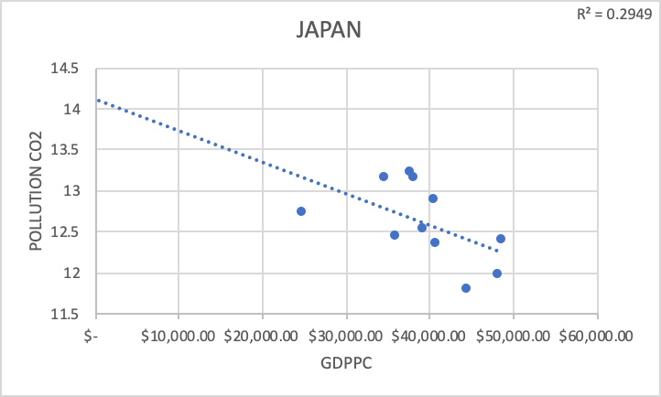
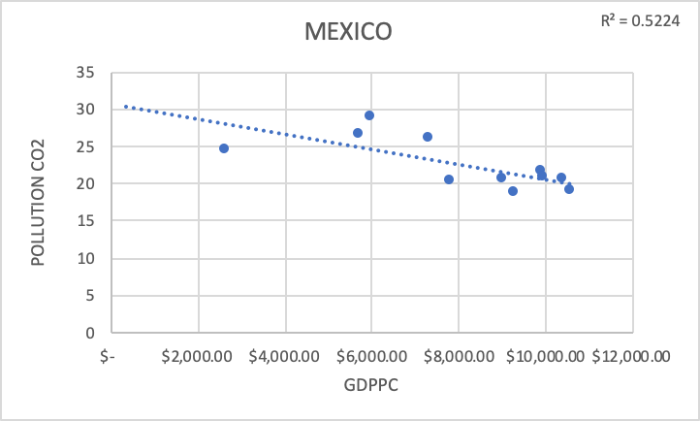
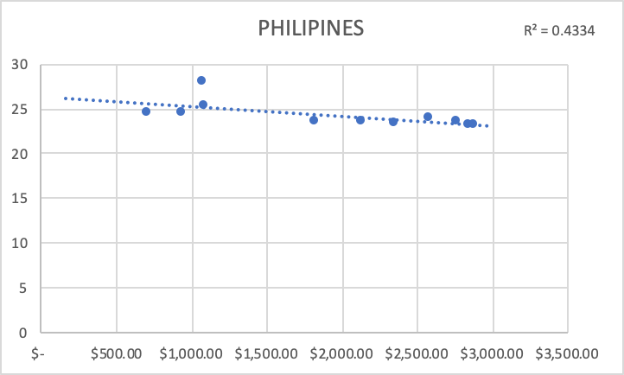
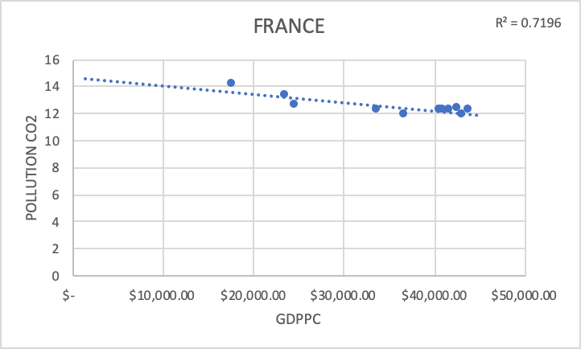
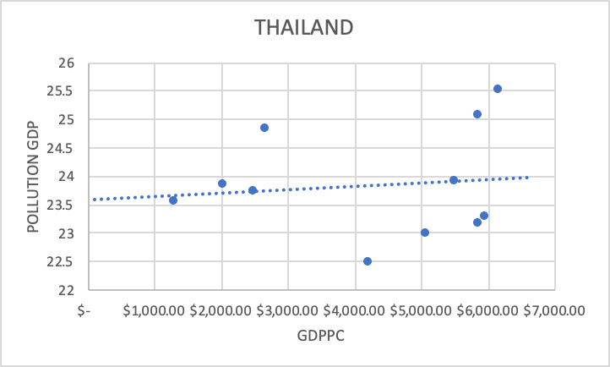
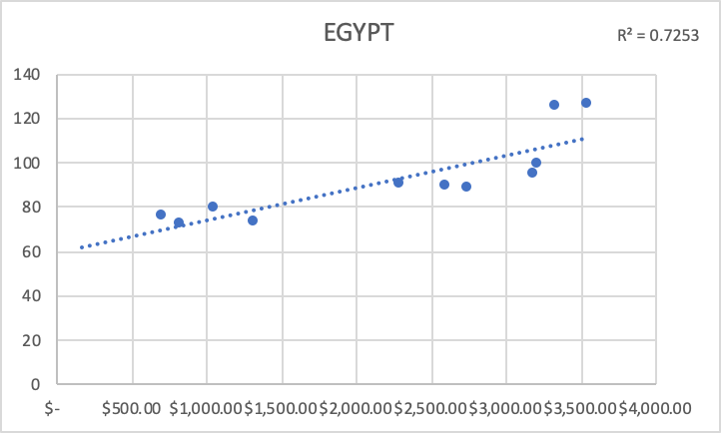
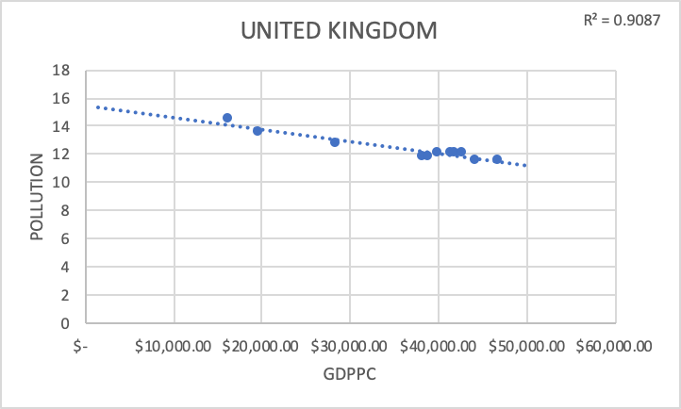
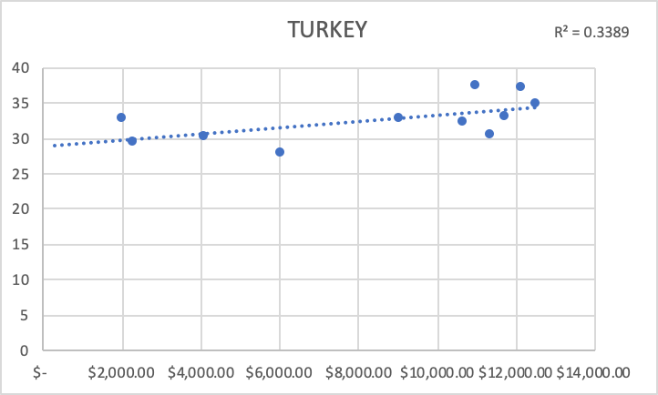
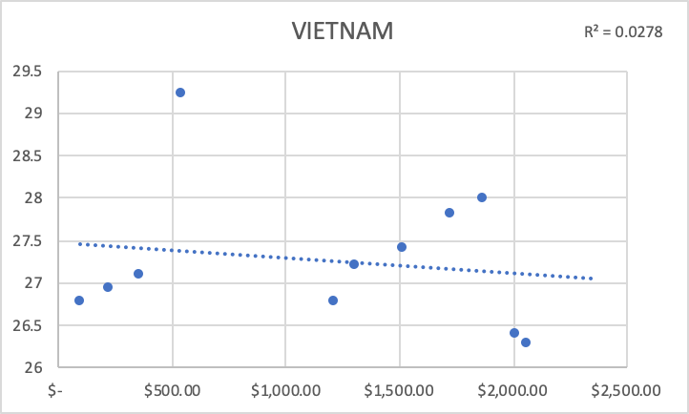
UNDERDEVELOPED
DEVELOPING
DEVELOPED
Notes:
FRANCISCO

Slide 14
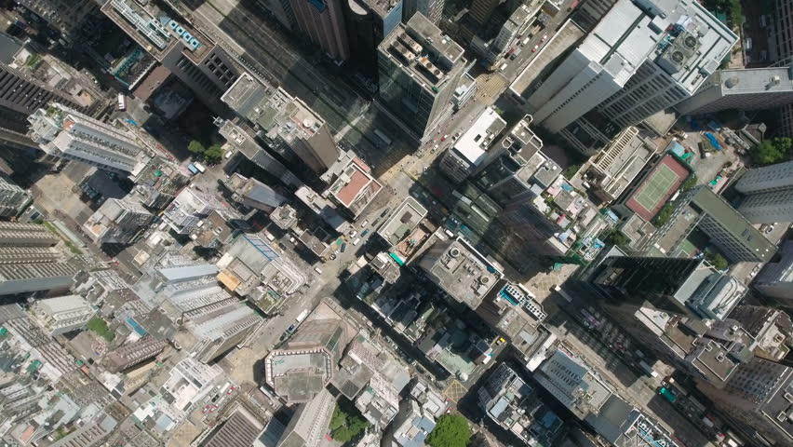
P L O T S

Slide 15
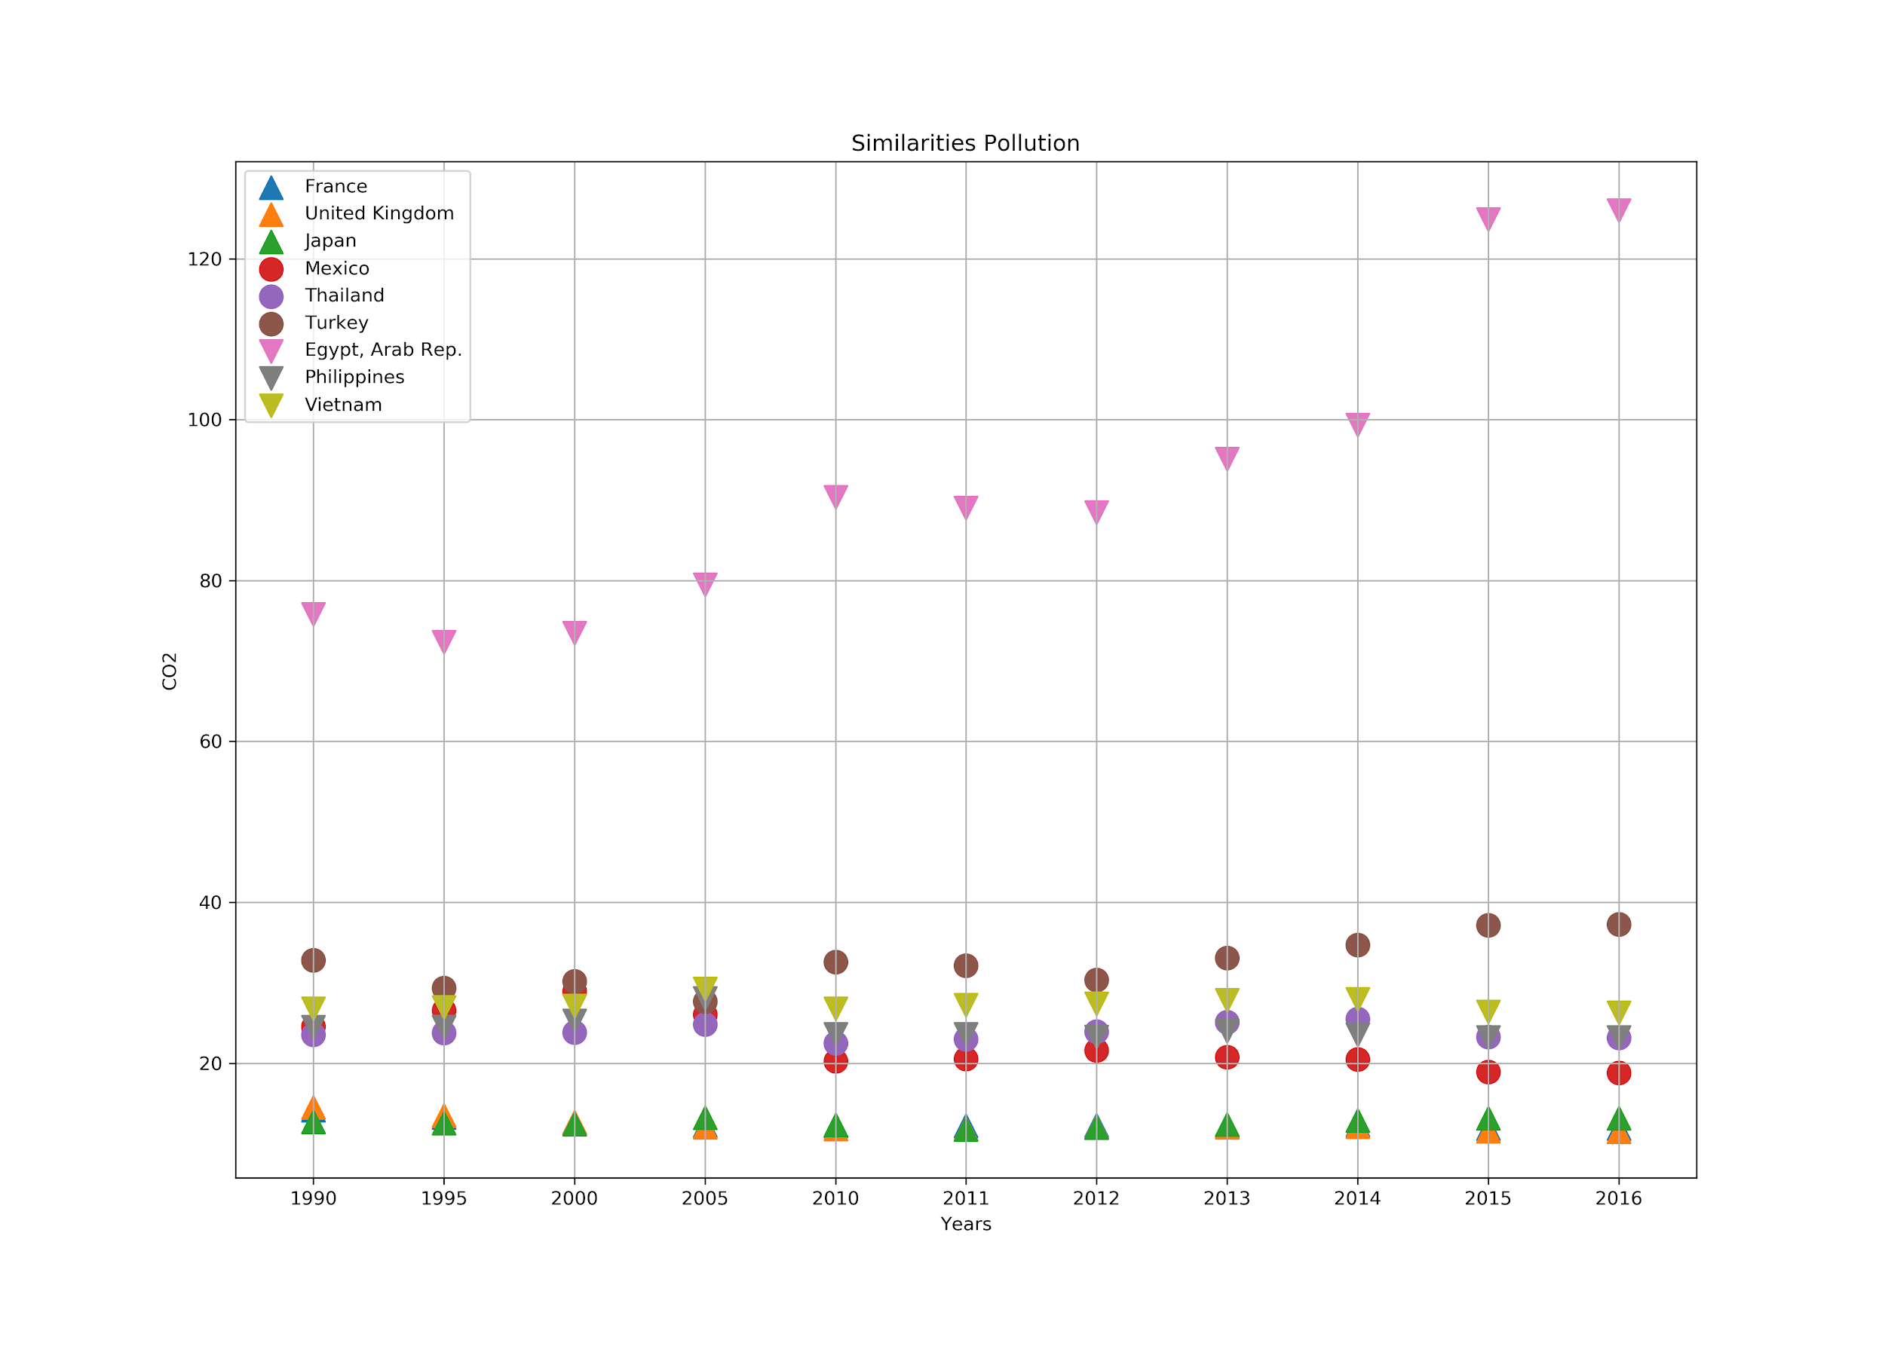
Notes:
Cantidad de CO2 (contaminación)
Morado. Egipto es una anomalía dentro de nuedtra info. Algunos en desarrollo tienen un

Slide 16
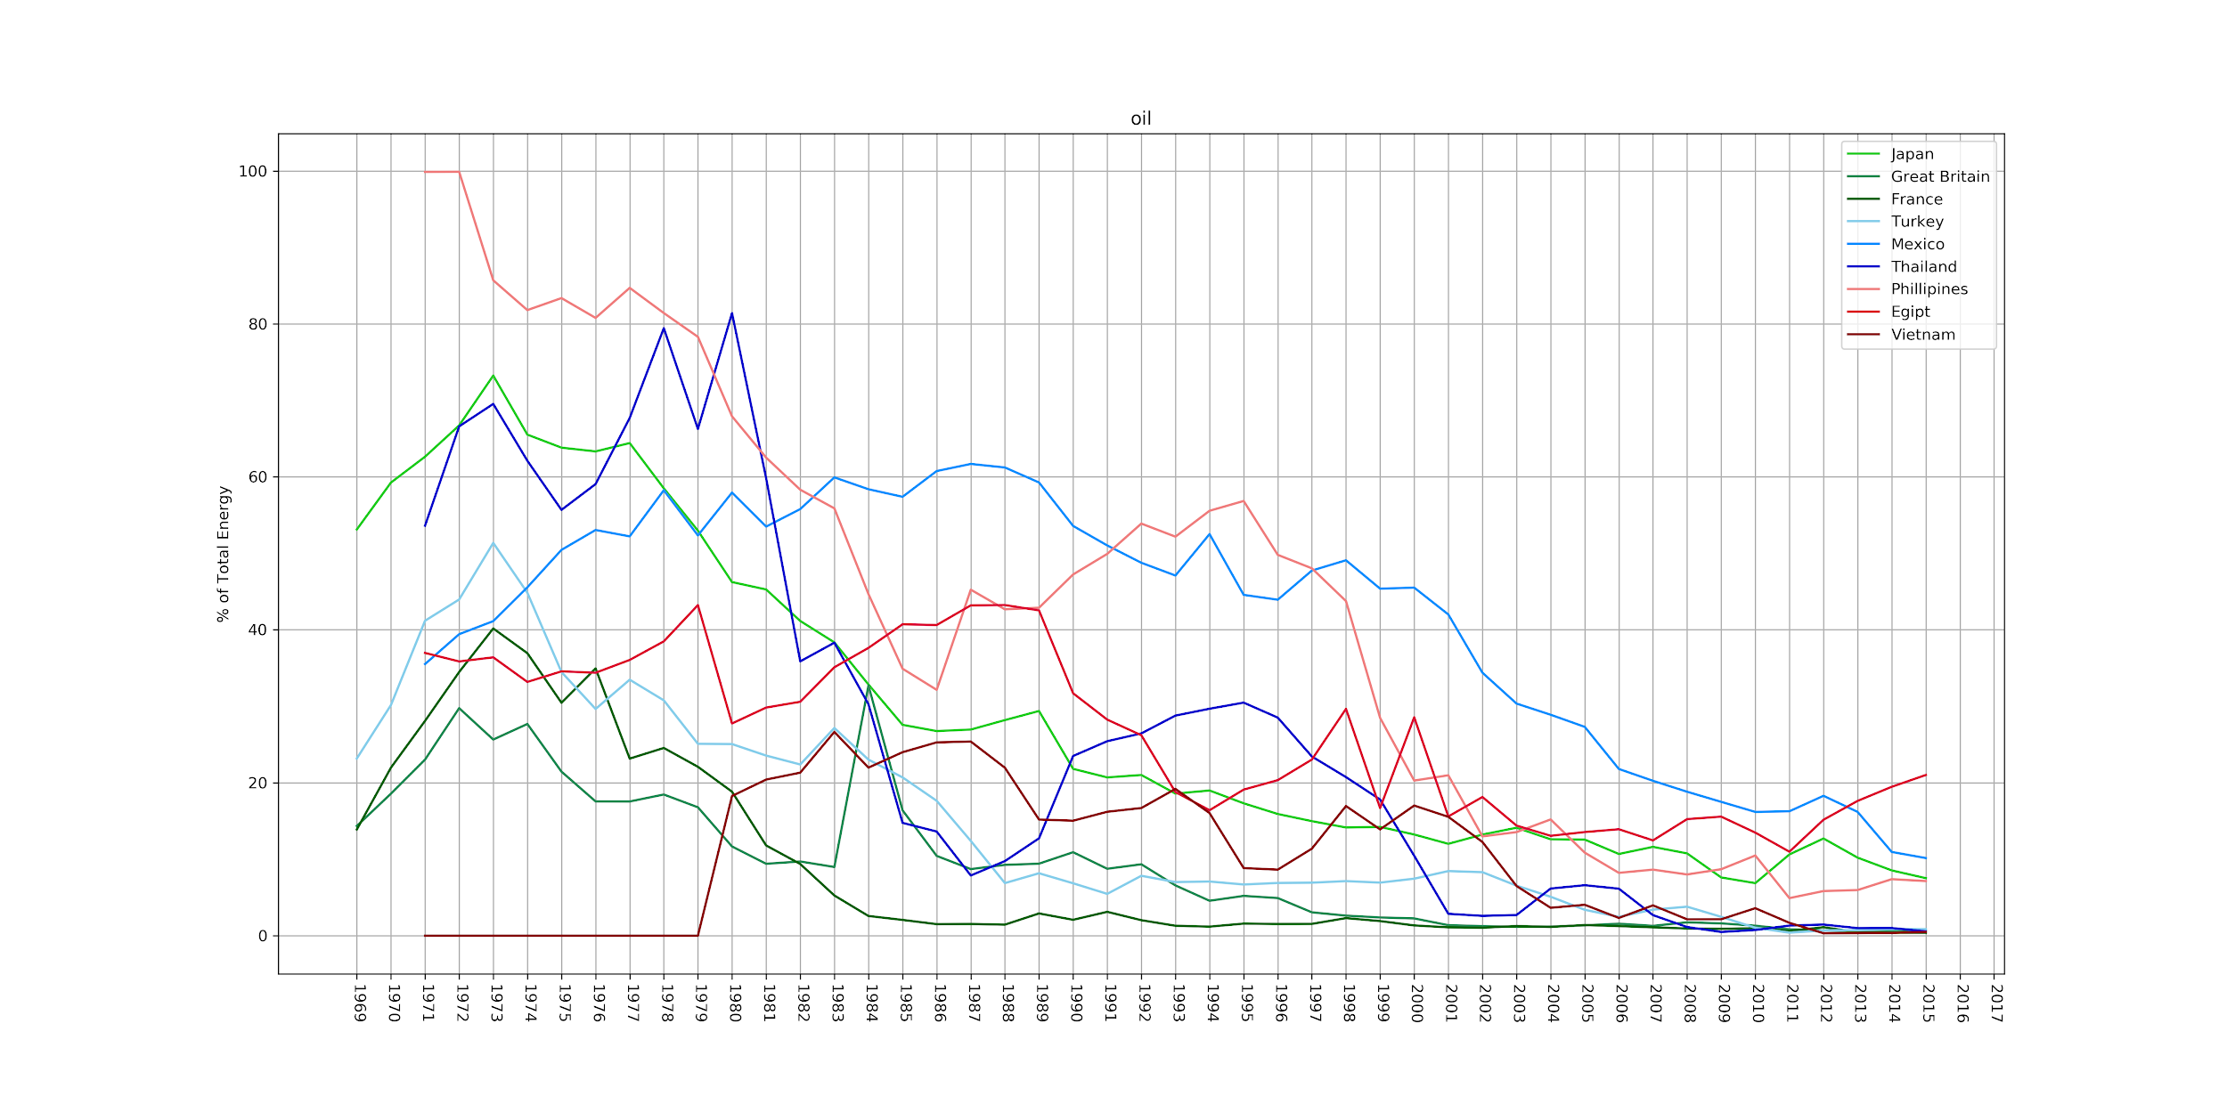
Notes:
Lauro

Slide 17
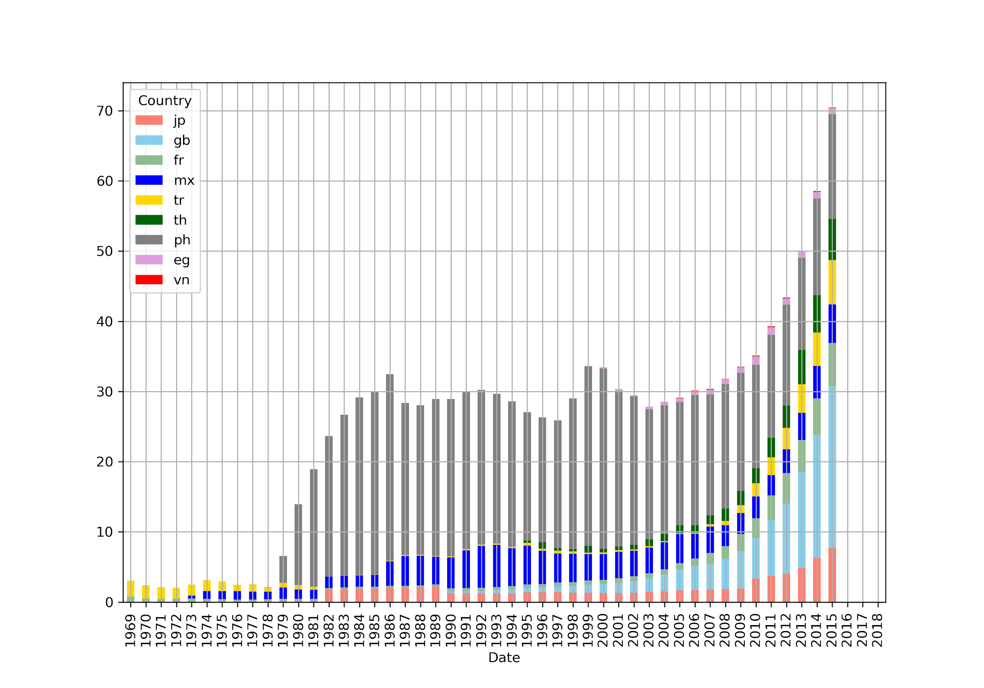
Notes:
Energía renovable usada
Lauro

Slide 18
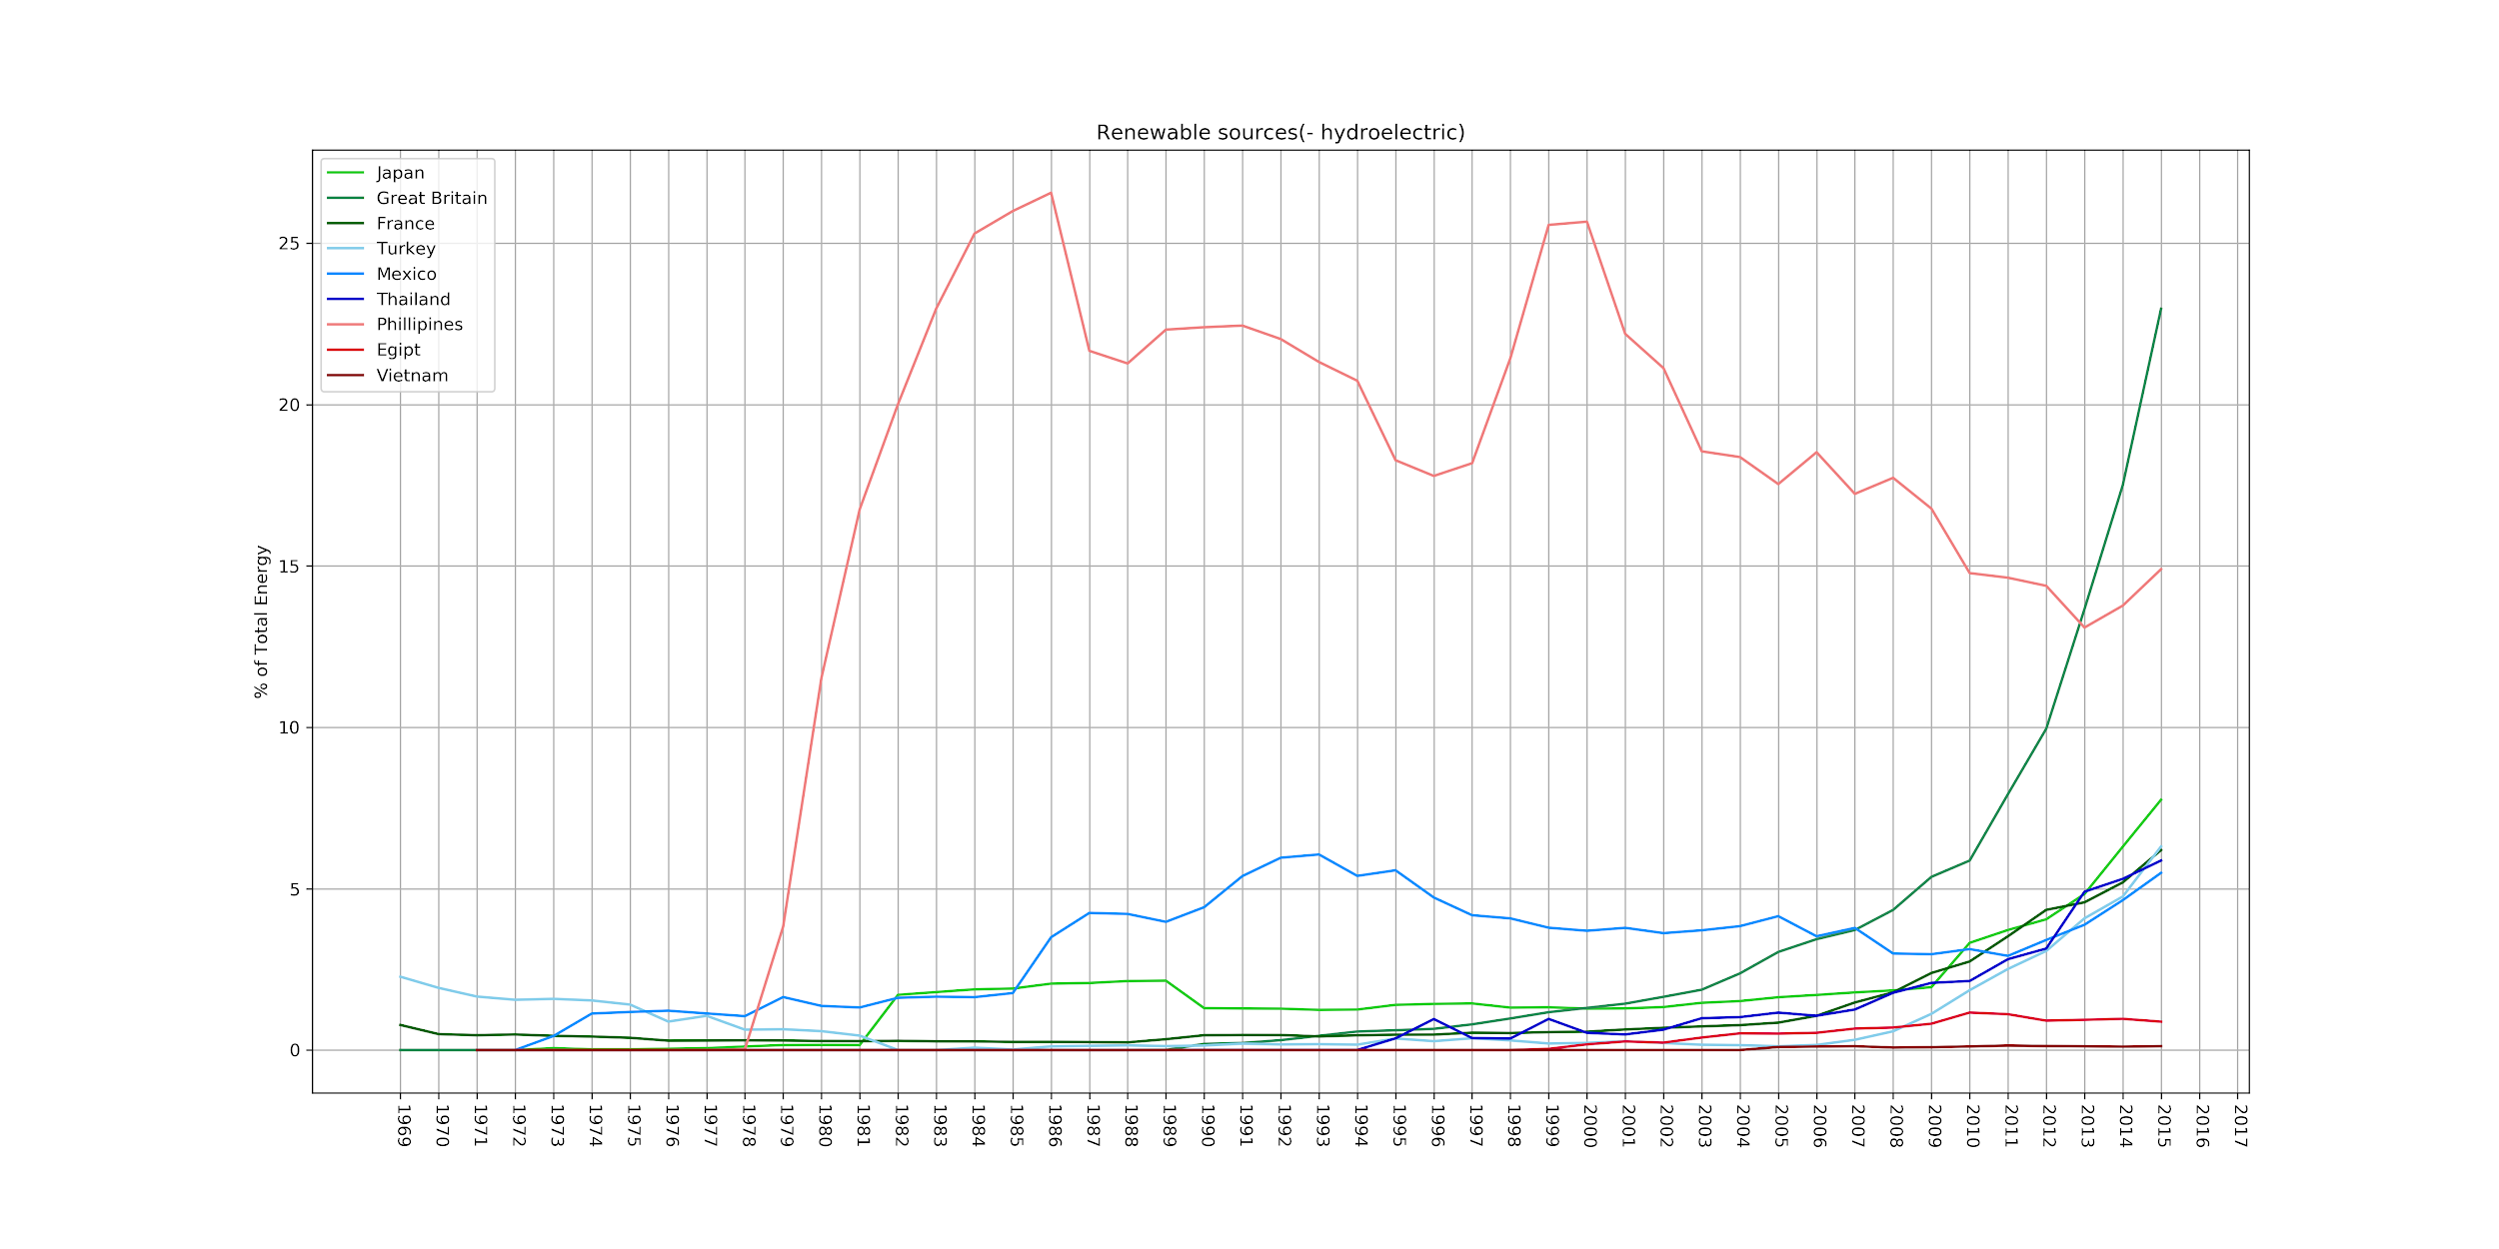
Notes:
Uso de hidroeléctrica
Lauro

Slide 19
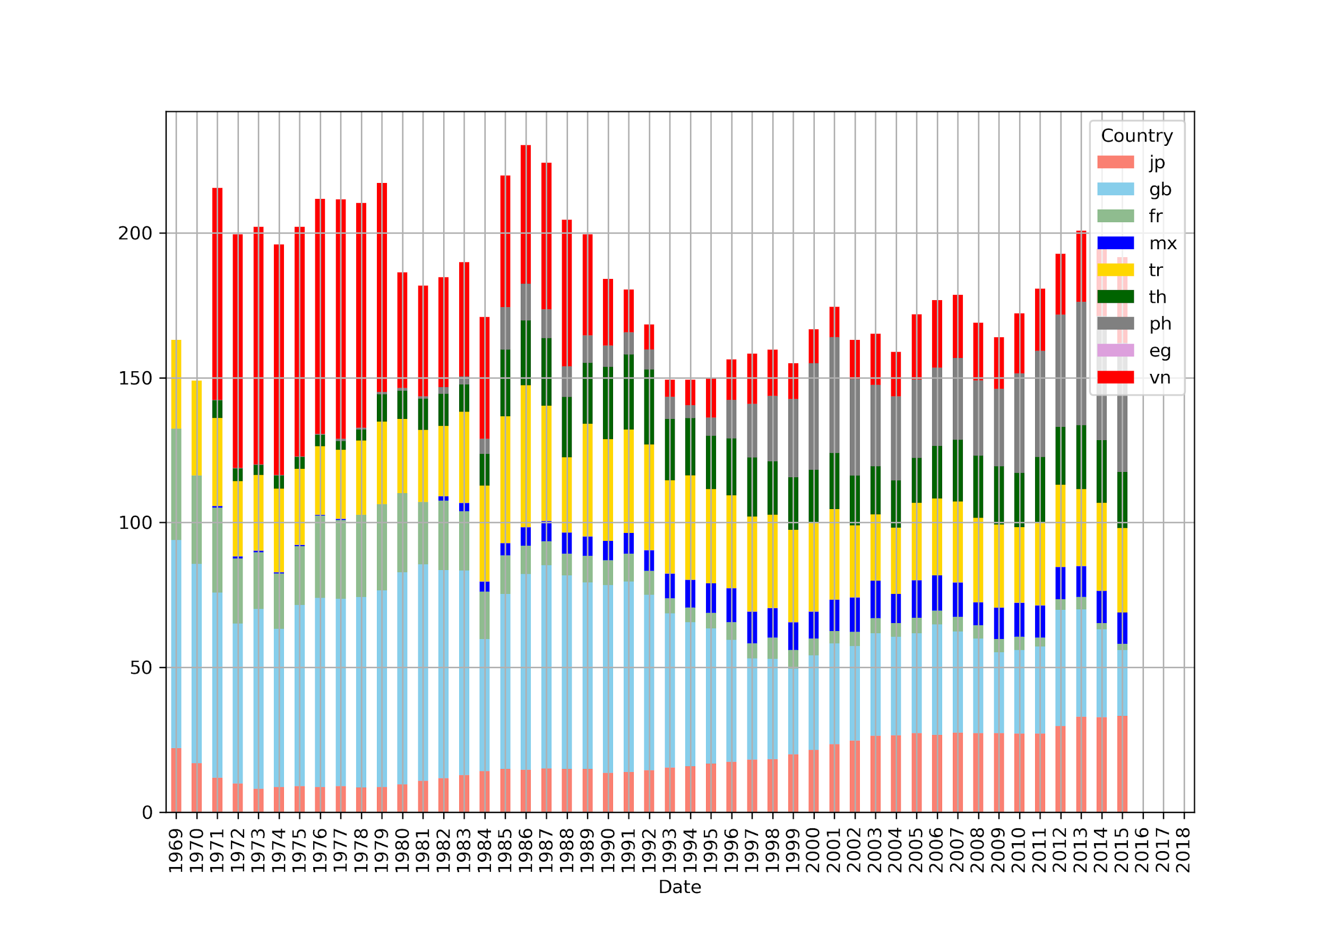
Notes:
Energía de carbón

Slide 20
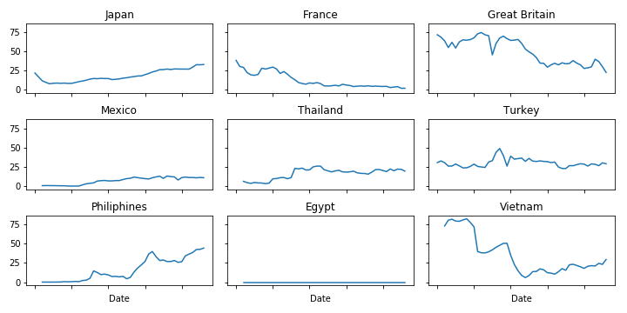
Notes:
Uso de carbón según el país
Lauro. En los países desarrollados el uso de carbón va a la baja con la fecha, los subdesarrollados experimentan cambios distintos a los esperados.

Slide 21
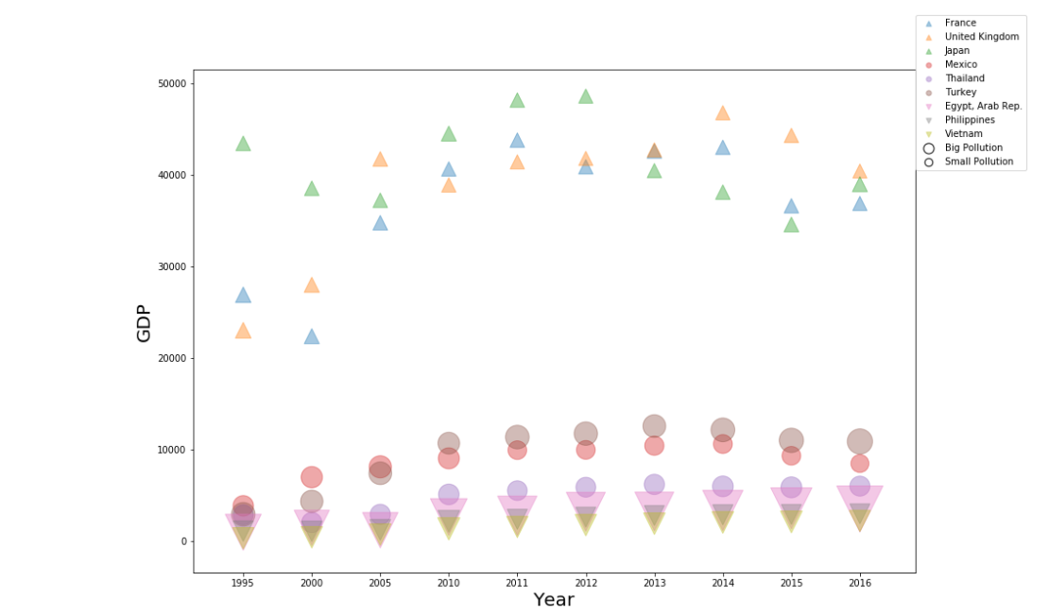
GDP

Slide 22
F I N D I N G S

